Slide 1
Media Control Profile(MCP) Introduction
Chunhao Jiang, CSPD
Jen, 2024

Slide 2
Agenda
Concepts
Service & Characteristics
ASE State Management
ASE Characteristics
ASE Control Point Characteristics
ASE State Machine
ASE Test Suite
Notes:
这是说

Slide 3
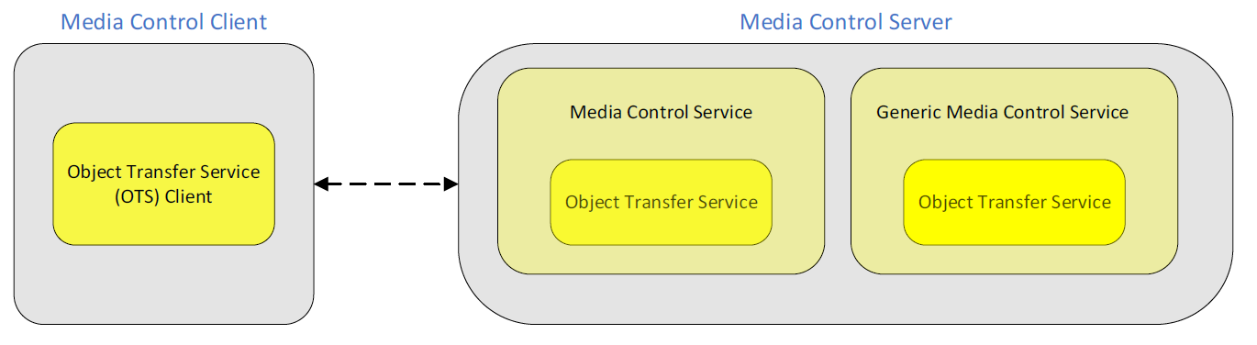
Concepts
Media Control Client: initiates playing and pausing, determines playing order, and collects search results from the Media Control Server.
Media Control Server: manage media tracks and conveys the various states and settings to the Media Control Client.
Object Transfer Service: Secondary Service, shall be included from the instance of the MCS or GMCS that it is associated with.

Slide 4
Media Control Client procedures
Read Media Information procedure
Discover the media player information on a Media Control Server.
Read the characteristic value of the Media Player Name characteristic. (Can be set notification)
When the Media Player Name characteristic is notified, the client should read characteristics such as Media Player Icon Object ID, Media Player Icon URL, and other characteristics that could have changed because of the Media Player Name change.
Read Media Player Icon Object Information procedure
discover the media player icon as an object in the included Object Transfer Service

Slide 5
Media Control Client procedures
Procedure | function | Propority | Notes
Read Media Information | Discover the media player information | Read | Read the characteristic value of the Media Player Name characteristic can be set notification.
Read Media Player Icon Object Information | discover the media player icon as an object | Read
Read Track Title | Discover the current track information | Read/Notify
Read Track Duration | discover the current track duration | Read
Read Track Position | discover the current track position | Read/Notify | Track Position characteristic is not notified to the client when the Track Position is changing because of playing the track.
Set Absolute Track Position | set the current track position on a Media Control Server to an absolute position. | Write
Set Relative Track Position | set the current track position on a Media Control Server to a position relative to the current track position. | Write/Notify | using the Move Relative opcode and the parameter set to the relative time of the move.

Slide 6
Media Control Client procedures
Procedure | function | Propority | Notes
Read Playback Speed | discover the current playback speed of the current track | Read
Set Playback Speed | set the playback speed of the current track | Write
Read Seeking Speed | discover the current track seeking speed | Read

Slide 7
Media Control Client procedures
Procedure | function | Propority | Notes
Read Media Information | Discover the media player information | Read | Read the characteristic value of the Media Player Name characteristic can be set notification.
Read Media Player Icon Object Information | discover the media player icon as an object | Read
Read Track Title | Discover the current track information | Read/Notify
Read Track Duration | discover the current track duration | Read
Read Track Position | discover the current track position | Read/Notify | Track Position characteristic is not notified to the client when the Track Position is changing because of playing the track.

Slide 8
Media Control Client procedures
Procedure | function | Propority | Notes
Read Media Information | Discover the media player information | Read | Read the characteristic value of the Media Player Name characteristic can be set notification.
Read Media Player Icon Object Information | discover the media player icon as an object | Read
Read Track Title | Discover the current track information | Read/Notify
Read Track Duration | discover the current track duration | Read
Read Track Position | discover the current track position | Read/Notify | Track Position characteristic is not notified to the client when the Track Position is changing because of playing the track.

Slide 9
Media Control Client procedures
Read Track Title procedure
Discover the current track information on a Media Control Server.
Read the characteristic value of the Track Title characteristic. (Can be set notification).
Read Media Player Icon Object Information procedure
discover the media player icon as an object in the included Object Transfer Service

Slide 10
Service & Characteristics
Service
There shall be no more than one ASCS instance on a server.
ASCS shall be a Primary Service and the service UUID shall be set to Audio Stream Control
ASCS can be instantiated on devices that can accept the establishment of unicast Audio Streams

Slide 11
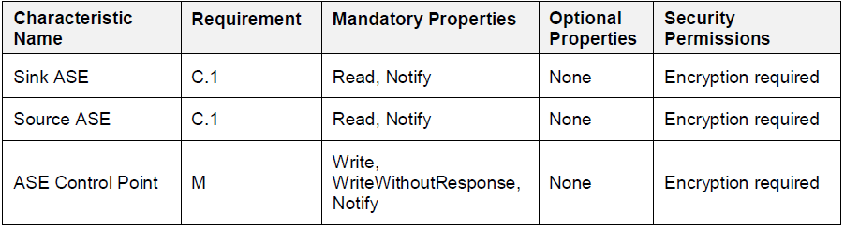
Service & Characteristics
Characteristics
Sink ASE Characteristic: The server is said to act as Audio Sink for that ASE. There can be more than one Sink ASE characteristic on the server.
Source ASE Characteristic: The server is said to act as Audio Source for that ASE. There can be more than one Source ASE characteristic on the server.
ASE Control Point Characteristic: An ASE Control Point characteristic that clients use to configure parameters for each ASE exposed by the server. The ASE Control Point characteristic is used to operate on all ASEs, distinguishing each ASE by its ASE_ID value. Only one instance exist on the server.

Slide 12
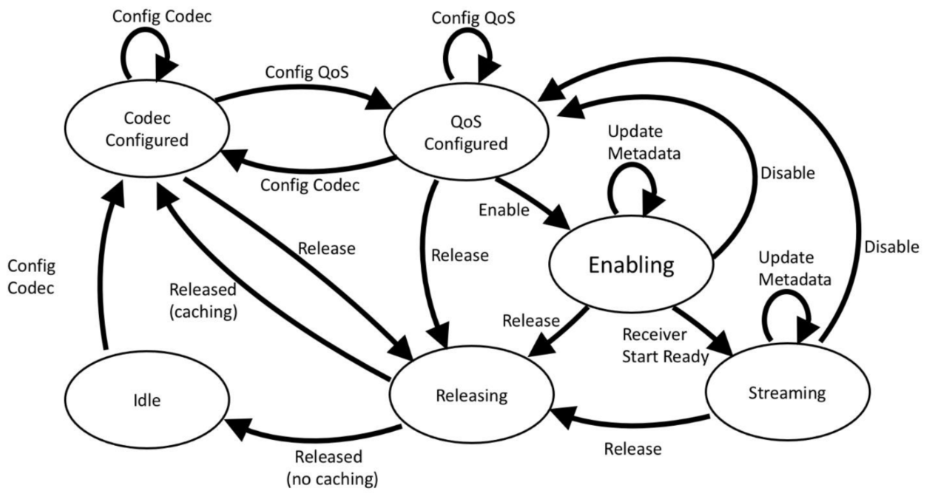
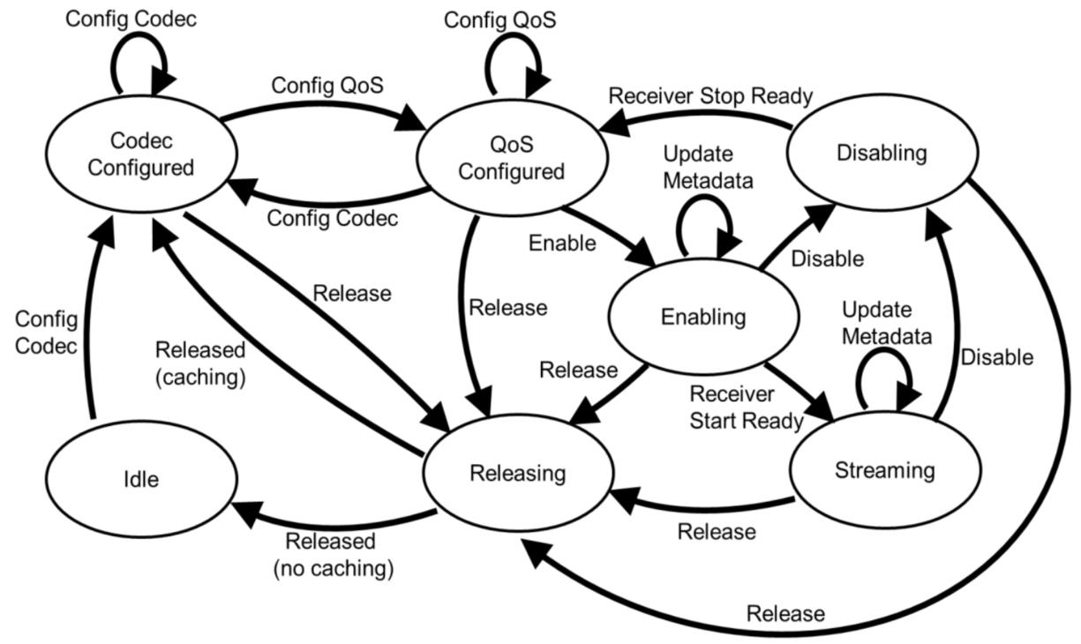
ASE State Management
Maintained by the server and shared with a
client using ASE characteristics.
State(ASE_state) & Operation(opcode)
Client can control state machine by writing to
the ASE Control Point characteristics
Server can autonomously control state machine
Client can read current state of server
Server can notify client current state
Sink ASE
Source ASE

Slide 13
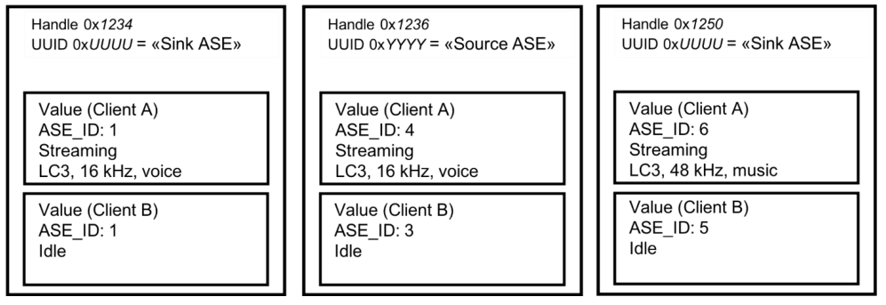
ASE Characteristics
Same characteristic have same UUID,
but have different handle, handle
indicate different stream, ASE_ID is unique in same client and in same UUID.
Client ASE reading or being notified ASE characteristic value cannot gain any information about the ASE characteristic value at the same attribute handle that is exposed for a different client.
The server should allocate local resources which can be affected by a change in the state of an ASE as it sees fit. The behavior of the server in deciding whether to accept client requests that can change the state of an ASE is left to the implementation.
If the characteristic value changed:
If connecting and notification is configured, then notify immediately
If not connecting but bonded, but notification is configured, then notify when reconnect

Slide 14
ASE Control Point Characteristics
The opcode is used by the server to determine which ASE Control operation is being initiated by the client.
A notification of the ASE Control Point is used to provide a response to a client-initiated ASE Control operation.

Slide 15
ASE State Machine
ASE Control operations can be initiated by server or client.
Initiated by client
Success: send a notification of ASE Control Point to client.
Can execute all of the operations except Released operation,
and send ASE values during that ASE Control operation.
Fail: send a notification to client with reason and additional
information.
Initiated by server
Can execute all of the operations, and send ASE values during
that ASE Control operation. Not send a notification of the ASE
Control Point characteristic value when completing an
autonomously-initiated ASE Control operation.
All of the parameters have Number_of_ASEs and ASE_ID[i]
Sink ASE
Source ASE

Slide 16
ASE State Machine
Codec Configurate
Target latency: expect server return meaningful
values for QoS preferences:
low latency, balance, high reliability.
Target PHY: 1M/2M/Coded
Codec ID: Coding format, Company ID, VS codec ID
Codec Specific Configuration
Sink ASE
Source ASE

Slide 17
ASE State Machine
QoS Configurate
The Config QoS operation is used to request a CIS
configuration preference with the server and to
assign identifiers to the CIS.
CIS can exist except Idle and Codec Configures,
because CIS parameters can be configured when
QoS configured
The server shall not accept the Config QoS operation
for that ASE if the configuration result in more than
one Sink/Source ASE having identical CIG_ID and
CIS_ID parameter values for that client
Parameters: CIS ID, CIG ID, SDU Inertval, Max SDU,
Retransmission Number, Max Transport Latency,
Presentation Delay
Sink ASE
Source ASE

Slide 18
ASE State Machine
Enable
Request the server to enable an ASE and to
provide any Metadata applicable for that ASE.
Start coupling ASE to a CIS.
If a CIS has been established and the server is
acting as Audio Sink for the ASE, and if the server
is ready to receive audio data transmitted by the
client, the server may autonomously initiate the
Receiver Start Ready, without first sending a
notification of the ASE characteristic value in the
Enabling state.
Sink ASE
Source ASE

Slide 19
ASE State Machine
Receiver Start Ready
Sink -> Source
Inform Source that the Sink is ready to consume audio data
transmitted by the Source.
Disable
Request the server to disable an ASE
Decouple CIS.
Disabling
Ensures consistent delivery and coordination of audio
streams.
Receiver Stop Ready operation
Client(Sink) inform a server (Source) that the client is ready to stop
consuming audio data transmitted by the server.
Sink ASE
Source ASE

Slide 20
ASE State Machine
Release
Request the server to release an ASE and all resources
associated with that ASE.
Released
Initiated autonomously by the server if:
The server has detected the loss of the LE-ACL for
an ASE in any state, or
Release have completed, and the server controller
has indicated that CIS has been torn down
Server can choose to cache a codec configuration
or not cache codec configuration
Sink ASE
Source ASE

Slide 21
ASE Test Suite
Generic GATT Integrated Tests
Additional Service Requirements
Server IUT supports a single instance of the Audio Stream Control Service and follows the requirements for the supported characteristics of the service when multiple ASEs are present.
Lower Tester executes the GATT Read Characteristic Value sub-procedure.
ASE Control Point Procedures
Different roles transfer to different status performance from different valid status.
The Lower Tester writes to the ASE Control Point and get the notification from server.
Server Initiates Released Operation from dropped LE-ACL
Lower Tester tears down connection and IUT start extended adv, Lower Tester reconnect and read characteristics by executing the GATT Read Characteristic (should be Idle or Codec Configured)

Slide 22
ASE Test Suite
Service Procedure – Error Handling
Invalid Opcode
Set a RFU value of opcode
Common Control Point errors
Set invalid ASE identifiers and Control Point commands of invalid length
Invalid ASE_ID Errors
Invalid Parameters for different operations
Invalid State Transition
Config QoS with Different ASE with Same Direction, CIG, and CIS

Slide 23
Thank you for listening!

